Slide 1
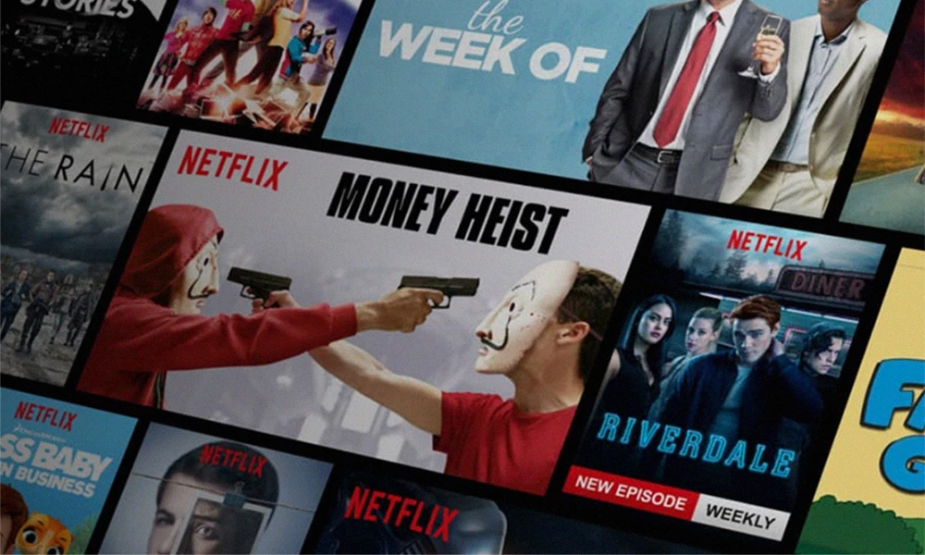
Movie Recommendation
Harika Yadav Gillela
Mohanaditya Karampudi
Shaolin Pu
November 2, 2020

Slide 2
Problem Definition & Significance
Cannot recommend fresh items.
Overspecialization: system does not recommend these items that are different from anything that the user has seen before.
Cold start problem.
Do not require user-items interactions before starting to search
Hard to include side features for query/item
Side features are any features beyond the query or item ID. For movie recommendations, the side features might include country or age. Including available side features improves the quality of the model.
The additional information can be, for example, the movie name, genre, PG rating, critic score, audience score, celebrity info, length of movie, release year, audience review etc.
Notes:
Recommendation systems - 92 percent of all consumers report that a word-of-mouth recommendation.
Collect relevant data from open-sources

Slide 3
Key Themes from Prior Literature
Challenge: Computation(very large matrices), Evaluation (improving the performance), Scalability & Deployment (imbibing in the production environment)
Data problems: Humongous data (break into clusters), Data sourcing and cleaning , Feature engineering(smart features, classifying data) and Data formatting (TF-IDF approaches, Calculating feature weightage).
Improving the recommendation algorithm: Apriori, semantic relations (LDA and maximum entropy), Hybrid (K-means and collaborative), Cosine similarity (movies, items)
Promising results: Overcome Cold Start, Personalized recommendations, scaling and better evaluation metrics
Papers: Movie Review Mining and Summarization, Content-Based Movie Recommendation Using Different Feature Sets, A Movie Recommender System, Feature weighting in Content Based Recommendation Using Social Network Analysis, YouTube recommendation systems and we recommendation system

Slide 4
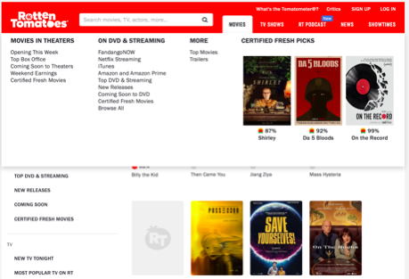
Data Source & Preparation
https://www.rottentomatoes.com
Around 10K movies
Data Cleaning and preprocessing
Attributes – 12 attributes
Director | Rating | Genre
Release Year | Movie Name | Critic Consensus
Critic Score | Audience Score | Studio
Top 5 Celebrities | Runtime | Rating in words

Slide 5
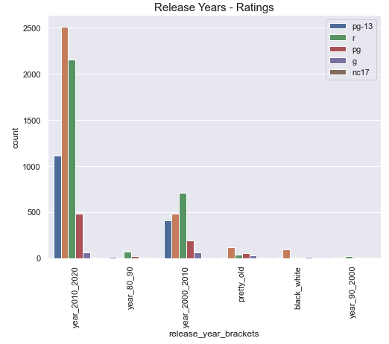
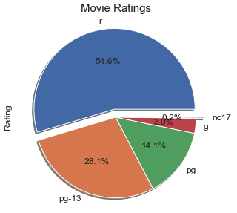
Exploratory Data Analysis &Visualizations
5 Categories of Ratings Release between years 1920 - 2020

Slide 6
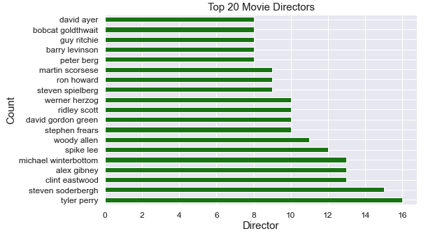
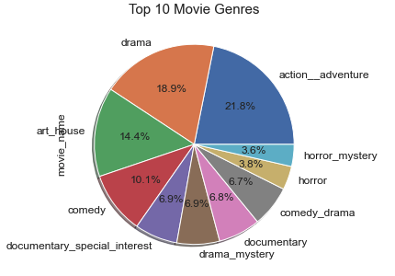
Exploratory Data Analysis & Visualizations
154 Genres
6453 Unique Directors

Slide 7
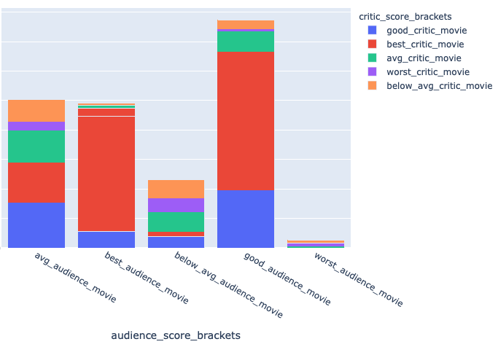
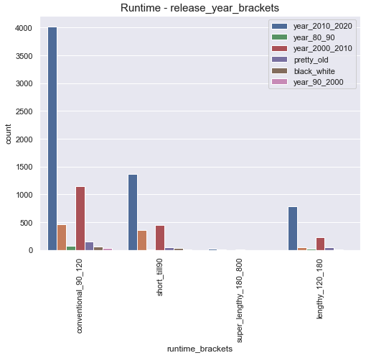
Exploratory Data Analysis &Visualizations

Slide 8
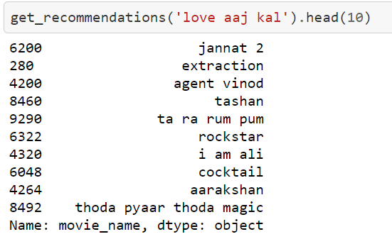
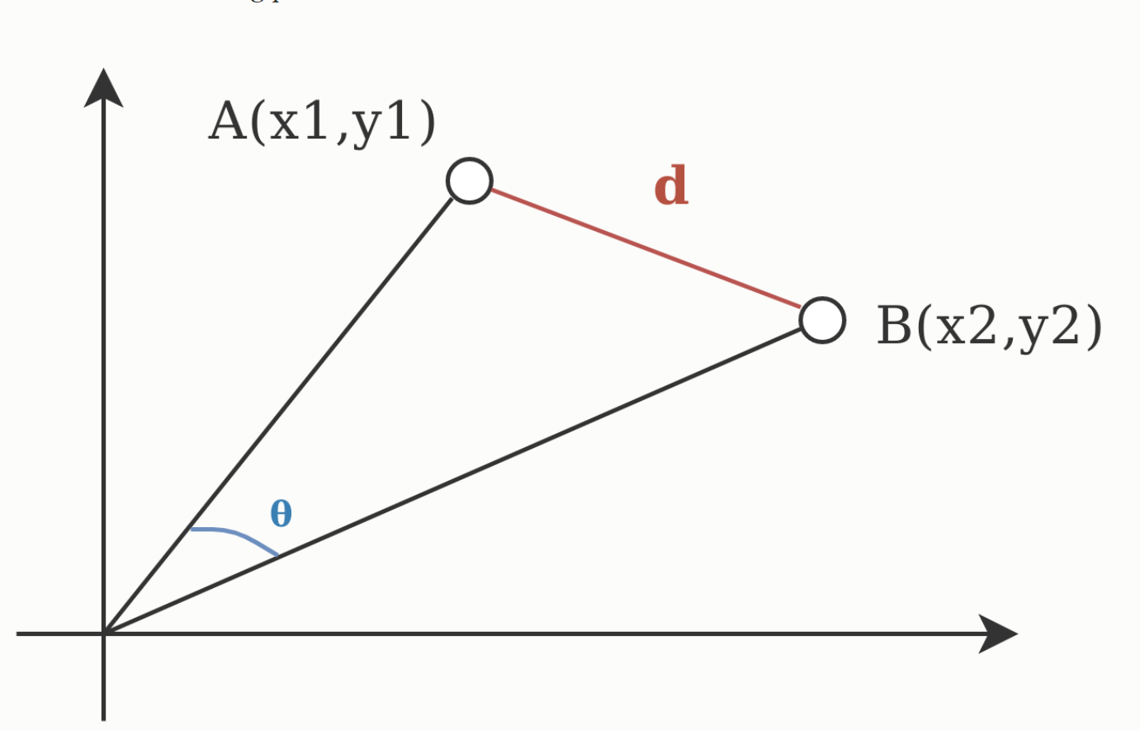
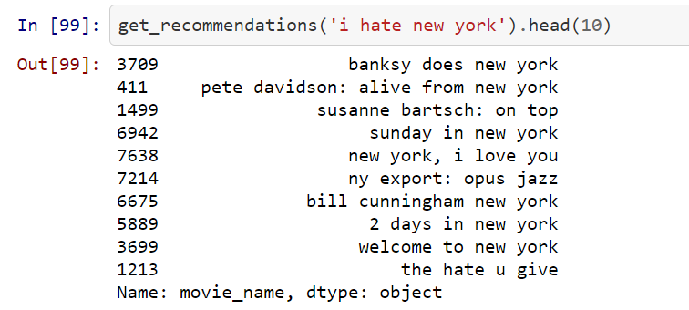
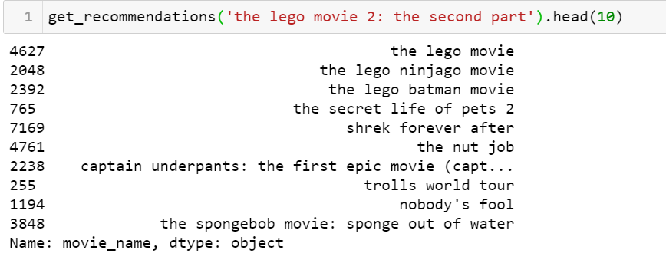
Text Analytics & Results
Euclidean and Cosine Similarity
While cosine looks at the angle between vectors (thus not taking into regard their weight or magnitude), Euclidean distance is like using a ruler to measure the distance.

Slide 9
Insights & Recommendations
92 percent of all consumers report that a word-of-mouth recommendation is the “leading reason they buy a product or service”
The movie recommendation system can be easily trained on new dataset of different domain thus making it easily scalable.
Find ways to collect the data by advertising and encouraging people to write/rate reviews.
Can help in creating campaign especially around product categories.
Win-Win situation for customer and business.
Maybe implement Neural Networks instead of cosine similarity

Slide 10
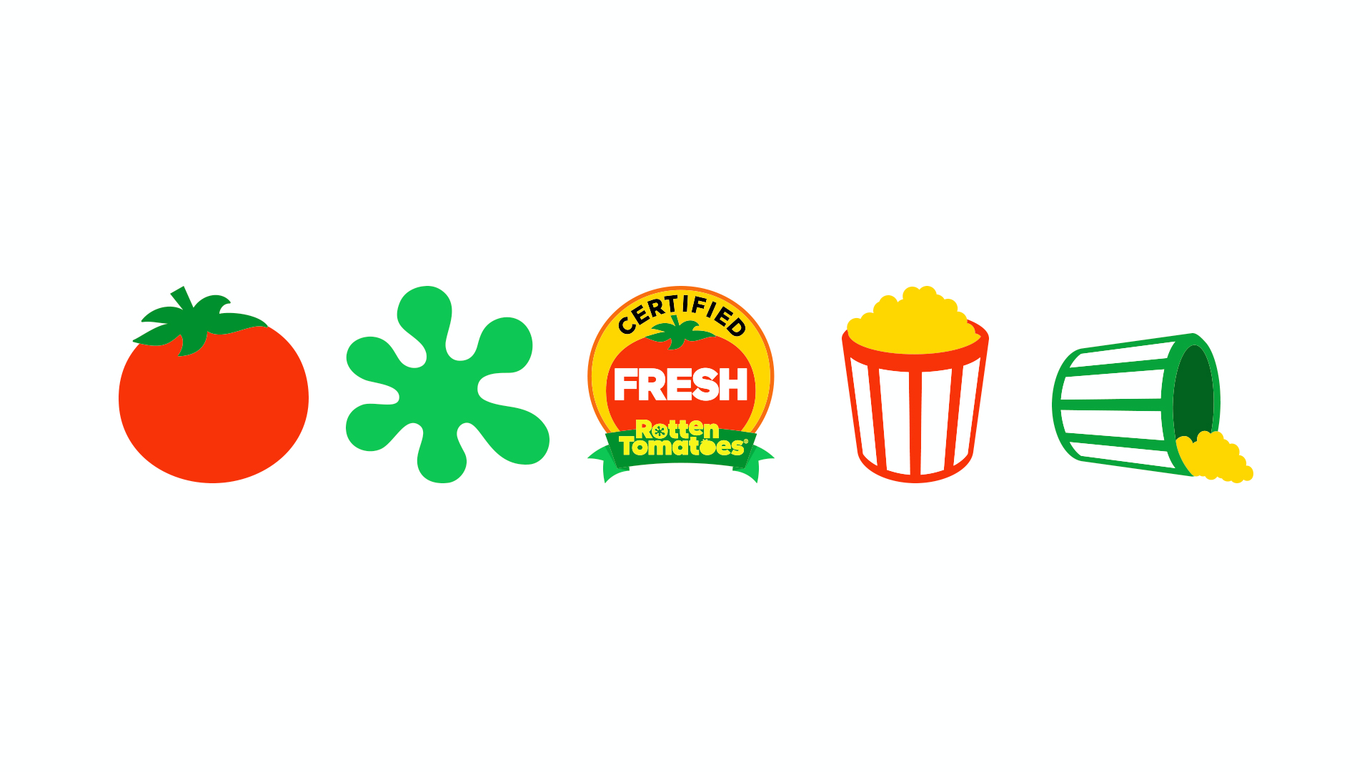
Thank You

